Slide 1

North Dakota Boat Registration
ND Boat Registration Search – Visit our blog for more details
BOAT ALERT HISTORY REPORTS
Notes:
Replace these:
[STATE]
[CODE]
[DMV]
Slide 2 – is it a titling state?
Slide 6 -
Slide 7 – fees info

Slide 2
Boaters should know about registration requirements, recording methods, and title search guidelines for the State of North Dakota
Some states have titling for boats and others do not. North Dakota is not a titling state. So boats are only registered but not titled
Go to the Game and Fish Department (NDGF) to get these
Boat Registration Numbers in North Dakota start with the letters “ND”
The Reg. No. must be displayed on the hull with a registration sticker
BOAT ALERT HISTORY REPORT

Slide 3
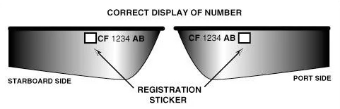
State Reg. No.
Not to be confused with the HIN Number.
BOAT ALERT HISTORY REPORT

Slide 4
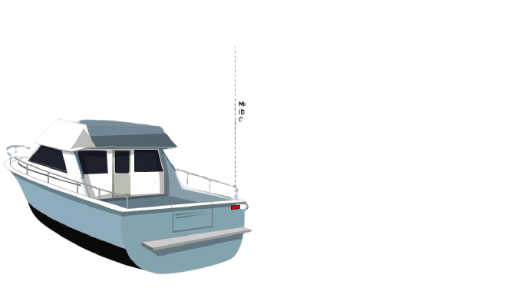
HULL ID Number location
A “State assigned” hull ID would have the letters “NDZ” in its 12 character HIN. All others would have the manufacturer code instead.

Slide 5
Liens In North Dakota
Liens are not recorded since this state does not issue titles but they might be in the UCC filings
Look for these on the registration certificate and title before you buy a pre-owned boat
If the vessel is USCG documented, a lender’s security interests will be recorded with the National Vessel Documentation Center (NVDC) (ordered at boat-abstract.com)

Slide 6
Boat Registration Lookup In North Dakota
Boat title and registration records in North Dakota are maintained by the Game and Fish Department (NDGF).
They don’t have a website to search HIN number for free but you can get this data in your Boat-Alert.com report.
BOAT ALERT HISTORY REPORT

Slide 7
Titling Requirement and Fees
Titling REQUIRED: No
EFFECTIVE DATE : 1/1/1990
Fee: 36 dollars (often changes with length of boat)
This state has not yet enacted UCOTVA
BOAT ALERT HISTORY REPORT

Slide 8
About Boat-Alert.com
The Boat-Alert.com database combines tens of nationwide databases into a single place so you can search in a matter of minutes.
These include records for stolen boats, marine lien claims, boating accidents, pollution incidents, auctioned boats, factory recalls, and boat manufacturers.
Some States will give more data than others.
BOAT-ALERT – The Carfax for Boats

Slide 9
Thank you for listening!
Website
www.boat-alert.com
Email
boatalert@ certifiedreports.zohodesk. com
Contact number
1-855-HIN-ALERT
BOAT ALERT HISTORY REPORT

Slide 10





FOLLOW US & SUBSCRIBE
Facebook
Twitter
YouTube
@boatalert
@hindecoder
Boat Alert
BOAT ALERT HISTORY REPORT

