Slide 1



How do you tell if a boat has money owing on it?

Slide 2


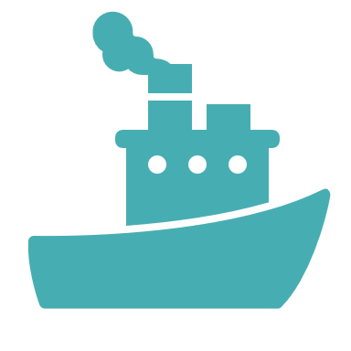
If a boat is sold, the new owner becomes responsible to pay the loan back

Slide 3
What are Marine Liens
A First Preferred Ship’s Mortgage is a mortgage that would be recorded against a vessel/boat that is documented with the United States Coast Guard
It is protected under the Ship’s Mortgage Act of 1920, and takes precedence/priority over all liens other than preferred Maritime Liens
The First Preferred Ship’s Mortgage assures the mortgagee the owner will properly ensure the vessel and refrain from encumbering the vessel
With the First Preferred Ship’s Mortgage, the owner will comply with all state, local, and U.S. laws and keep vessel document current and on board the vessel, along with a copy of the Mortgage

Slide 4
What are Marine Liens
The mortgagee is assured the owner will not leave the country without intending to return, abandon the vessel or sell, mortgage, or charter the vessel without the consent of the creditor/mortgagee

Slide 5
What is a HIN
A hull identification number is the serial number of the boat that is issued by the manufacturer and affixed to the hull of the boat
You can use this to lookup the HIN in public databases to search for Liens/encumbrances
Boat-Alert.com blog has an article you can read all you wanted to know about hull id numbers

Slide 6
Types of Tilting States
Not all States in the USA issue titles for boats
Some will only register the boat and only a handful of states will include a salvage brand on the title
This is why it is important to check the title for any indication of liens but the absence of a lien on the title does not rule out all types of money owing on that boat

Slide 7
How to lookup a Marine liens for USCG documented boats
If your boat is large enough, it will be required to be documented with the U.S.C.G. instead of being registered at the State level
The abstract of title will show all bills of sale and bank names so you can find the mortgages and if they were satisfied or not
This will help you determine if the boat has money owing on it

Slide 8
How to lookup UCC filings
What if your state DMV does not record liens?
Well, many liens and claims will be recorded with the secretary of state in your state as a UCC-Filing
Want to know more about UCC Liens and how to use them to lookup if a boat has a loan owing on it?

Slide 9
How is a maritime lien enforced?
Enforcement requires filing a complaint in federal court, naming the vessel itself as a defendant and arresting the vessel pursuant to a warrant of arrest issued by the court
What is the order of priority of maritime liens?
It is best to consult a lawyer regarding maritime law as it can get complicated but generally maritime liens are taking priority over other liens in situations where there are many claims on the vessel

Slide 10
What about liens for boats in Canada?
You can hire companies to do a Lien Check Service and thus search personal property registries
You can also search for liens at your province registrar office for around $5 usually

