Slide 1


Why you need a
Bill of Sale for your Boat

Slide 2
Today, we will cover:
What is a Boat Bill of Sale?
Conditions for a Boat Bill of Sale
Moveable and Tangible Assets
Information Contained Within a Boat Bill of Sale
‘As Is’ Condition
Maritime Liens
Reasons for Having a Boat Bill of Sale
Type of Boat – Pleasure Craft or Small Vessel?
How Does a Boat Bill of Sale Differ From a Sales Agreement?
Creating a Boat Bill of Sale – Important Questions to Answer
Your State will require one to transfer the title.

Slide 3
Other things we talk about today
Drafting a Bill of Sale for boat
Boat Bill of Sale Templates
Filling Out a DIY Template

Slide 4
What is a boat bill of sale?
The boat bill of sale consists of a document that provides proof of legal transfer of a boat’s ownership from one party to another
Bills of sale can also be used for other movable and tangible property such as cars, caravans, aircraft, personal property, and so on
Therefore, the boat bill of sale is suitable for any type or size of craft, ranging from the largest cruise ship to the smallest dinghy

Slide 5
Conditions for a Boat Bill of Sale
The person transferring ownership must own the property
The transferred property must be ‘moveable and tangible.’

Slide 6
Information Contained Within a Boat Bill of Sale
Seller’s identity
Buyer’s identity
A statement confirming the seller is legally entitled to sell the boat
Property description and what is included in the sale
Statement covering any ‘as is’ conditions
Year the boat was built
Hull identification No.
Odometer reading & date of sale
The vessel’s make and model
Purchase price of the boat and all equipment included in the sale

Slide 7
Other Information Contained Within a Boat Bill of Sale
Any maritime liens existing on the property
Signatures of buyer and seller
Date of the sale

Slide 8
‘As Is’ Conditions
When you sell a boat ‘as is,’ you are indicating to potential buyers that you want no further dealings with the buyer regarding the transaction once the deal has been concluded
‘As is’ clauses are there to inform the buyer that the deal is final
Therefore, you might consider using an attorney if you intend to use ‘as is’ clauses within a boat bill of sale

Slide 9
Maritime Liens
A lien is like an insurance policy set against an asset as a form for security of payment of another obligation
The asset owner is referred to as the lienee, and the party who benefits from the lien is the lienor or lien holder
A maritime lien is automatically in place at the point at which the fuel is delivered, repairs are carried out, or other services get rendered

Slide 10
Reasons for Having a Boat-Bill-of-Sale
Whether you are the buyer or the seller of a boat, naturally, you want to get the transfer ownership as quickly as possible
However, a boat bill of sale is essential for both parties
If you buy a boat that it not titled, the Bill of sale becomes a MUST otherwise you won’t be able to register the vessel

Slide 11
Benefits & Reasons to get a boat bill of sale

Slide 12
1. Provides Peace of Mind
The main reason bills of sale are used is that they provide proof of sale or ownership transfer. Required by the State.
This condition is crucial when transactions involve used personal items, where there are no other means of determining ownership
In sales involving cash payments, a bill of sale also provides proof of payment

Slide 13
2. It States What You are Getting For Your Money
A boat bill of sale should describe more than merely what the boat is
It should detail trailers, motors, or other equipment, such as fishing gear or water activity accessories included in the sale or transfer
A trailer can be crucial for not only removing a boat from the water, or moving it from one place to another; it also comes in handy for storing a boat during the winter or out of season

Slide 14
3. It Provides Proof of Ownership
A bill of sale documents the transfer of a boat from its owner to its new buyer
It is an important document that serves the purpose of providing proof of the buyer’s ownership
This will be useful for tax purposes and in case you are stopped/inspected by the USCG; or even in case a theft happens!

Slide 15
4. It Lays Out the Boat’s Condition and Warranties
The bill of sale will clearly state the condition of the craft and its equipment
A boat bill of sale will also inform you the seller has included no representations or implied warranties with the sale
The buyer will have the opportunity to inspect the boat, along with a mechanic or boat surveyor if they wish to use either

Slide 16
5. It Provides the Boat’s Location History
Of course, but having the location on the bill of sale gives you, as a buyer, a documented history of the vessel’s life
1
You may not have been aware that the boat was previously berthed 3,000 miles away across the ocean
2
That may be insignificant if it’s a cruise liner, but it could require considerable maintenance after such a voyage if it is a smaller craft
3

Slide 17
6. It Details Previous Ownership
A bill of sale gives you the security of knowing who has owned your boat previously
Should there be any queries about the boat’s activity during a specific period, you can trace the previous owners to provide information

Slide 18
7. It Ensures the Vessel is Moveable and Tangible
In the era of online commerce, there are many opportunities for unscrupulous sellers to be ‘flexible’ in their descriptions
You might think you will be sailing off into the sunset in a vintage riverboat, only to find it has been used as a restaurant for the past twenty years and is now attached to the quay!
A bill of sale ensures the asset you are buying is moveable and tangible, so there is no room for underhanded sales tactics

Slide 19
8. As Is
We explained what an ‘as is’ condition means earlier
You must understand any ‘as is’ conditions that exist in the sale, as these could influence your decision to buy or the price you’re prepared to pay
The bill of sale must include any ‘as is’ conditions, protecting both the buyer and seller from any dispute in the future

Slide 20
9. Mandated by law
Fraudulent selling of assets is a serious crime and can cost buyers significant money and stress
Bills of sale are mandated by law as a measure to restrict the potential for fraud
By ensuring you use a boat bill of sale, you protect yourself as either a buyer or seller

Slide 21
10. Purchase Price
Price is one of the primary considerations in buying or selling a boat
During negotiations, prices will be offered, declined, revised, and ultimately agreed upon
The bill of sale records the agreed price, so there can be no ambiguity about what you are paying or receiving for the vessel

Slide 22
DIY Boat Bill of Sale
What price is the boat?
Who is the boat’s seller?
Who is the boat’s buyer?
What is the boat’s condition?
boat’s make and model
boat’s location

Slide 23
Boat Bill of Sale Templates
As we’ve just mentioned, writing a bill of sale from scratch increases the risk of you omitting crucial information
Let’s face it; nobody wants to waste time producing a document from scratch, only for it to be full of errors and lacking essential information
Get an affordable Boat Bill of Sale tailor made for your situation, country and state – link below!

Slide 24
Conclusion
Even if you are a one-time boat owner, you will need to be familiar with a boat bill of sale
There are many reasons you need to use a boat bill of sale, and, hopefully, this article will have informed you of these
A boat bill of sale helps ensure that all of these are checked
Your State will require one to transfer the title.

Slide 25
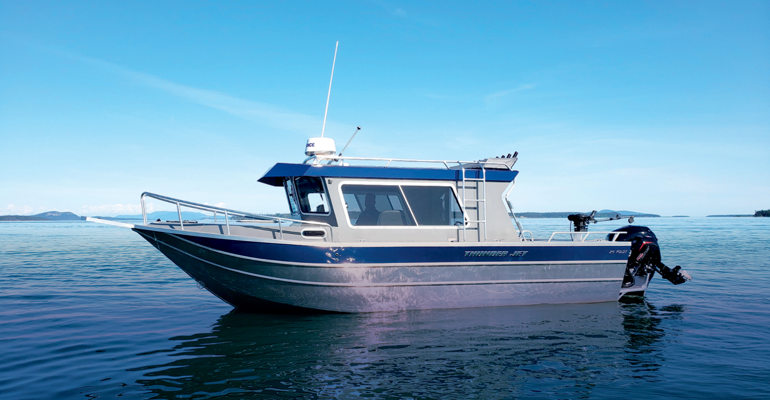

Thank you for Listening!
Full Article:
https://www.boat-alert.com/blog/why-you-need-a-bill-of-sale-for-your-boat/
Website:
www.Boat-alert.Com
Email:
Boatalert @certifiedreports.Zohodesk.Com
Contact Number:
1-855-HIN-ALERT

Slide 26





Facebook
@boatalert
Twitter
@hindecoder
YouTube
Boat Alert
FOLLOW US AND SUBSCRIBE

