Slide 1
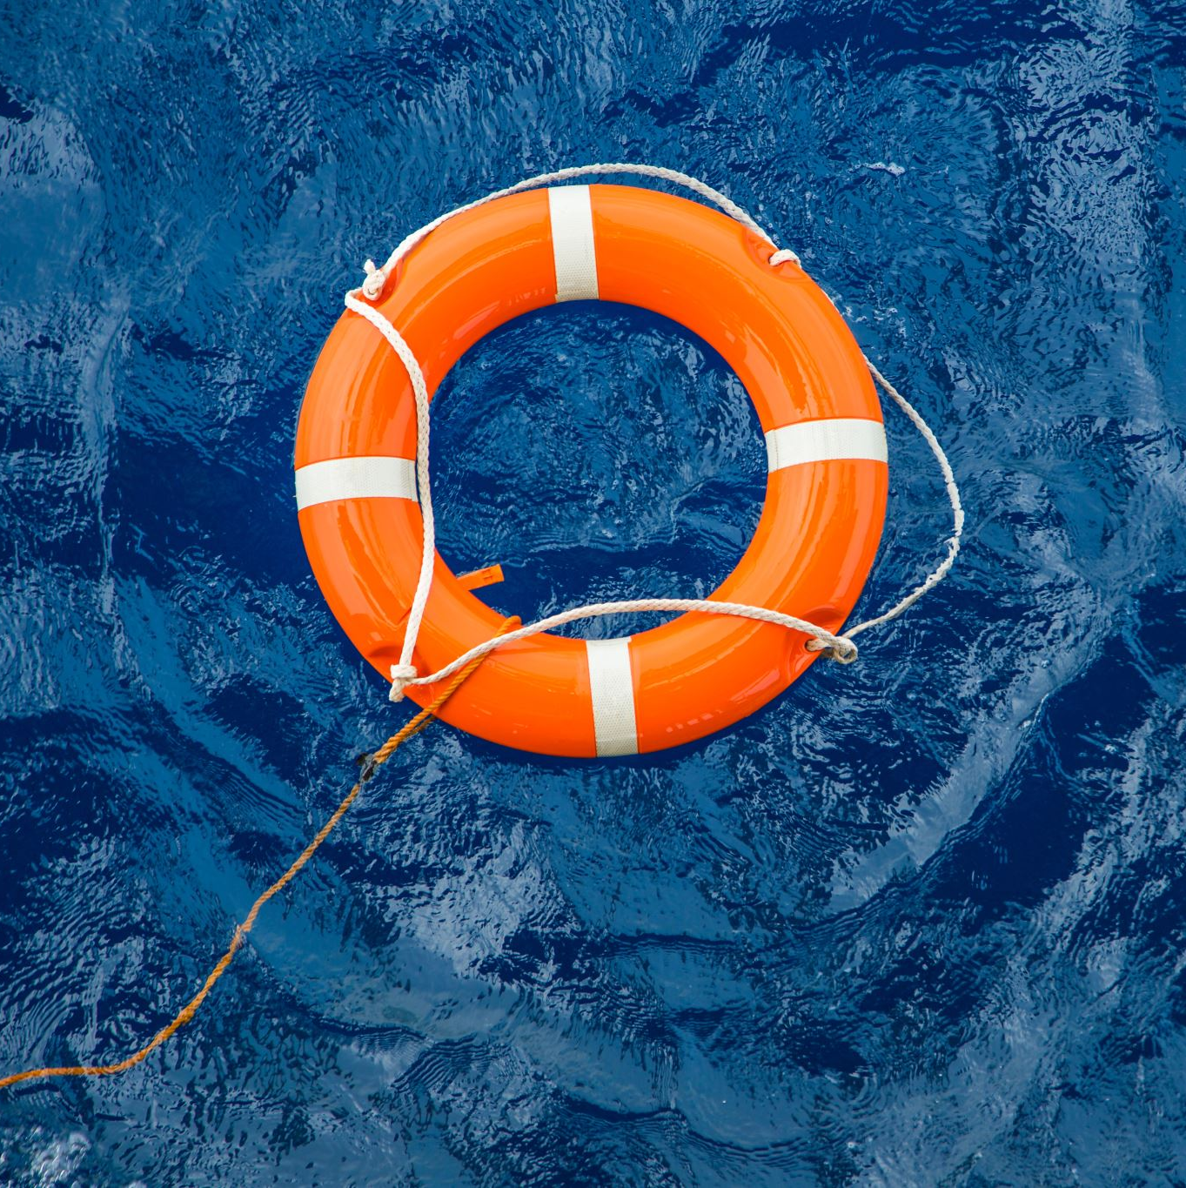
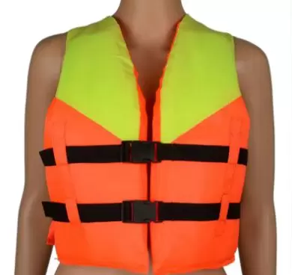

How To Choose a Life Jacket For Your Boating Trips | All About PFDs

Slide 2
Life Saving
Life jackets are essential for water activities such as recreational boating, kayaking, inflatable boating and canoeing

Slide 3
What are PFDs?
A life jacket is a personal flotation device that is available in a variety of shapes, colors, sizes and materials
Some life jackets are robust and durable, while others are made to protect against cold water
No matter which life jacket you choose, make sure that the right one offers the right level of safety for you

Slide 4
The Importance of Life Jackets
A life jacket or personal floating device is the most important piece of equipment on your boat, and the most important consideration is size
More than two thirds of boat deaths are drowning victims and 90% of drowning victims do not wear life jackets
Buy a life jacket that you can wear anywhere because it can save your life

Slide 5
PFDs and the Law
Federal law requires all boats to be equipped with at least one portable life jacket for each passenger on the boat, including types I, II and III
The goal is simple: the style, fit and method of use of the life jacket influence how well your PFD performs the task it is supposed to perform
Life jackets, life jackets and ski vests all have their common names, but a PFD is a personal floating device

Slide 6
PFD Label
A life jacket must be approved by the US Coast Guard or the government in your country or region
Type II jackets are designed to turn an unconscious person face up in the water
The offshore vest provides a lot of buoyancy and freedom of movement, while the wearer of the seat belt is tied to a jacket to stay connected to the boat
The second style, similar to Watersports PFD, adapts to a comfortable and secure fit so that the vest remains in position even when entering the water

Slide 7
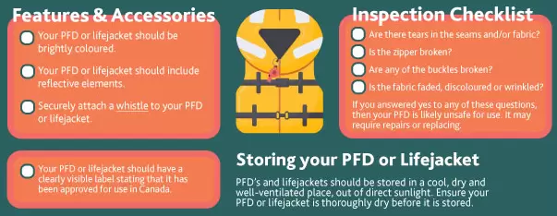
Features of PFDs to look for
Note: If your boat is over 16 feet long, federal law requires that you have at least one type of lifejacket for each person in your boat

Slide 8
Getting the Correct Sizing and Fit
It is important that you invest in the right life jacket before you take to the water
At the very least, the wrong size can be uncomfortable to wear and restrict movement, which is not ideal
When it comes to buying the right PFD life jacket, it is important to remember that you are looking for a device that fits your chest size, not your weight

Slide 9
PFD Classification
Life Jackets For Adults
Life Jackets For Kids
Life Jackets For Dogs

Slide 10
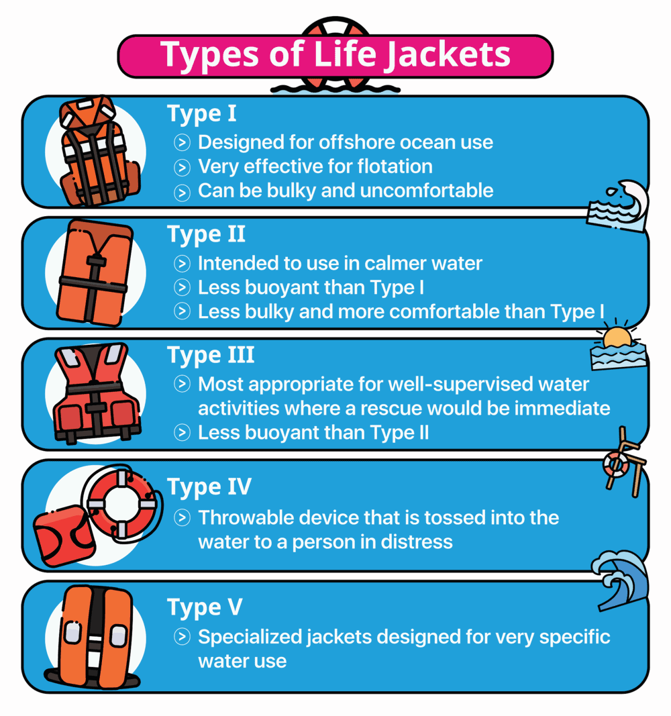
The Different Types Of Life Vests
Type I: Offshore Life Jacket
Type II: Near-Short Buoyant Vest
Type III: Flotation Aid
Type IV: Throwable Device
Type V: Special Use Device

