Slide 1
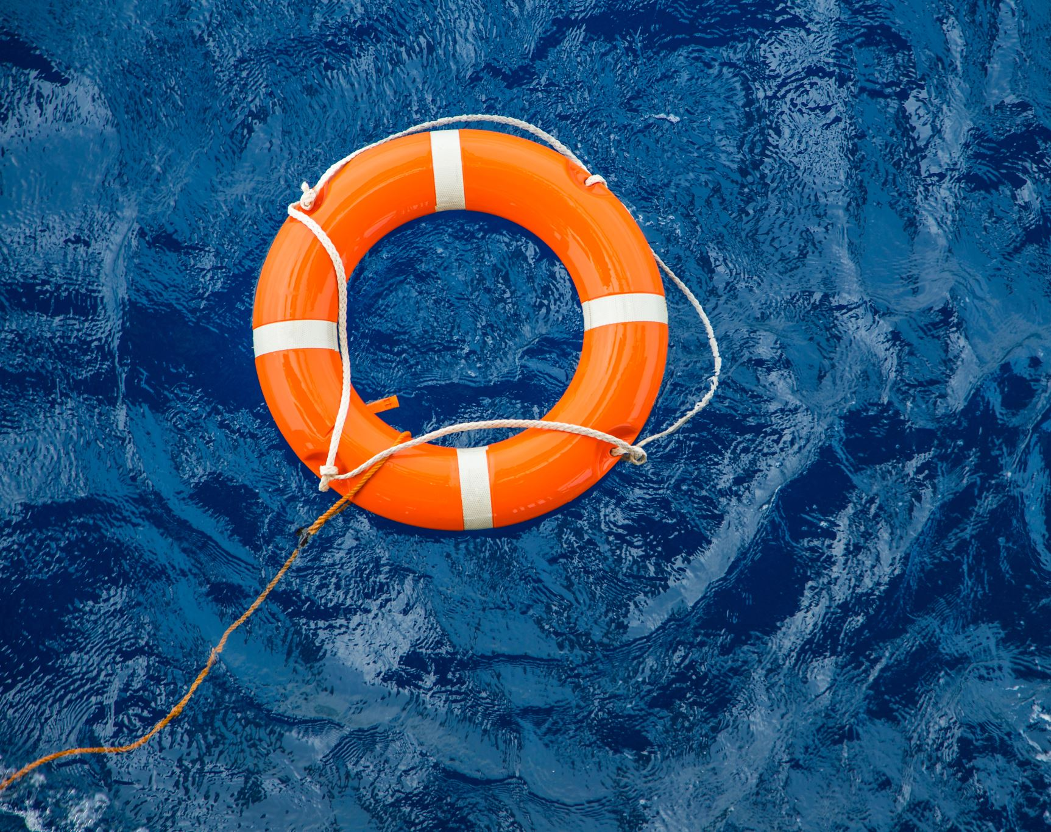

Boating Etiquette 101

Slide 2
Wave hello!
The friendliness of the boaters and the willingness to help each other make boating so special!
Keep the tradition alive on the waters and around the harbor
Remember that there is no substitute for learning the rules, guidelines and laws of your lake, marina or other boat location
Boating Safety and Etiquette Boat etiquette is not just about social norms, it is also about safety, so it is good to learn a few rules before loosening the ropes
The rules of the road are numerous and detailed, but if you only learn a few, you will be covered in most recreational boating situations
It is an accepted system of right of way, which one must follow in order to be polite and safety-oriented

Slide 3
Priority boats
The Coast Guard gives the same priority to these two types of vessels
The basic rules for motor and non-motor boats have a pecking order, but when it comes to getting different ships under different conditions, this is determined by who stands between the ships

Slide 4
Anchoring Boats
When you enter an anchorage, reduce your speed to avoid generating a wake
The noise is carried by the water and you want to disturb your neighbors as little as possible
Avoid traveling near fishing boats or along shores when they do not seem to move
As a rule, the anchor is considered to be the first person in the anchorage and determines the swing radius
When you drop anchor for a break in the evening, pay attention to your distance from other boaters
Not all boaters are old salts, and if you see someone having difficulty mooring their boat or trailer, offer help
Sunscreen, sunglasses, sea sickness medication, a waterproof jacket, non-slip footer, and a warm sweater should be on your list

Slide 5
Navigation Speed
You should make every effort to know the requirements that are expected of all boaters, even if you encounter merchant ships, fishing or submersible boats and law enforcement personnel
In any case, you should operate at a safe speed, give in to ships when in doubt and avoid collisions, even if this means breaking the rules of navigation in order to save lives and property from damage
The navigation rules include steering rules , sound signals, equipment requirements and there is even a section on navigation lights

