Slide 1

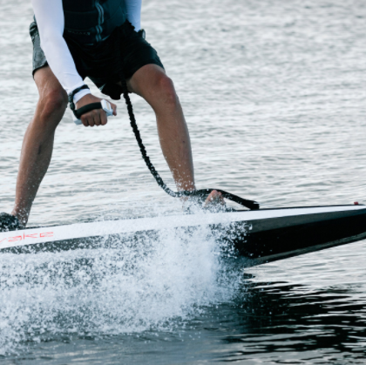
All About Jet Boards
What is a Jet Board?

Slide 2
The Jet Board is used in water sports
Image of a Jet Board
Sometimes called jetSurf or jet surfboards With the introduction of the jet board, a new water sport has emerged, the so-called jet boarding
We have covered Personal Water Craft like Jetski before in our article on selecting the Right Personal Water Craft

Slide 3
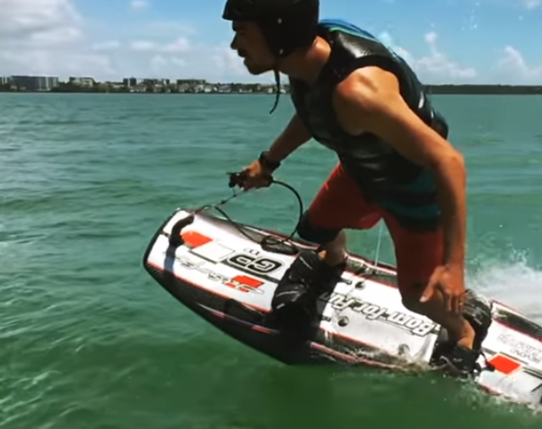
What is a Jet Board?
A jet board is a surfboard that is motorized

Slide 4
History Of Jet boards
The Jetboard is one of the earliest motorized surfboards manufactured between 1965 and
The original designer was a former engineer for Boeing aircraft
The jetboard is designed to use trim flaps and rollers for aircraft to control foot acceleration

Slide 5
How to Use a Jet Board
To start the engine underwater, pull the start handle from the top of the deck to the engine hatch
The driver fastens the strap around his ankles with flexible wires lined with magnets
The air is fed into the engine via a controlled valve in the nose of the board surface

Slide 6
Surf Boarding
The typical body of the board is made of lightweight carbon and can reach speeds of up to 60 km/h
With scientific evolution, high-speed carbon-fiber boards have gained popularity
Most Jet Boards are powered by a 21 kW lithium battery, this offers a reported run time of 90 minutes and allows the rider to control the speed with a portable Bluetooth remote control
If you want to race with friends, Potter Bay’s mobile app offers drivers four driving modes depending on their mood: experience, children, eco-sport and extreme

Slide 7
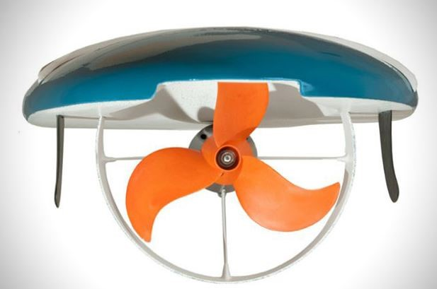
Electric Surf Board
For low budgets the Electric surfboard is another option: An electric surfboard is similar to the standard surfboard you see everywhere
Of the other three, electric surfboards have the most power to help you reach high speeds
Electric standing paddleboard: These are called SUP boards and have a similar function, but are not motorized

Slide 8


New innovations
Cabratec
Hydrofoiler XE

Slide 9

New innovations
Flyride

