Slide 1
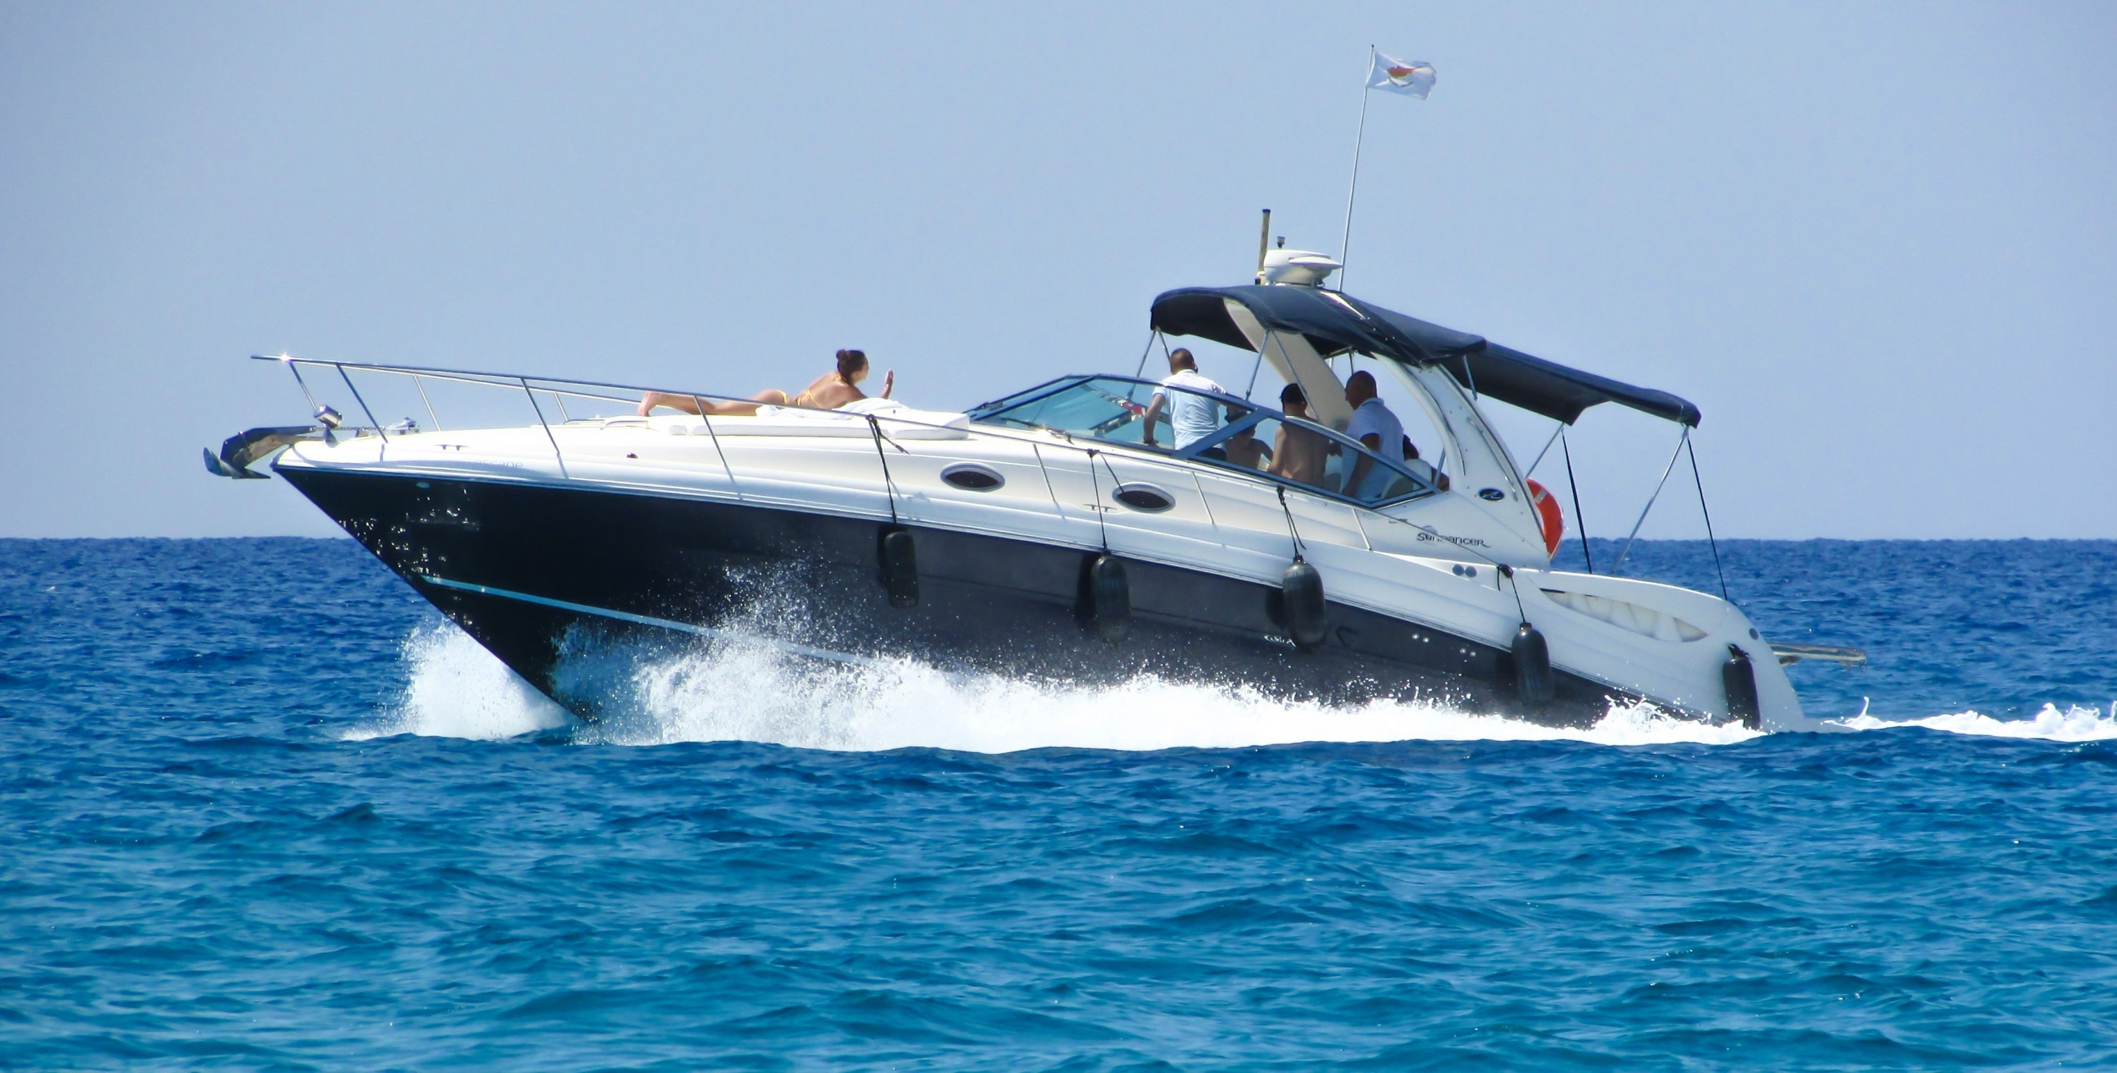

What are Bowrider Boats
Overview of Bowrider Boats

Slide 2
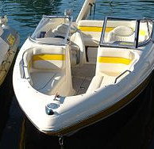
Bowrider Boats Overview
There are numerous types of boats in the market, and one commonly noticed type is the Bowrider.
Two people at the front bow and leaving other guests to either sit in the back or side seats.
It can be utilized for all sort of enjoyment, from travelling to watersports and even more
A bowrider is commonly geared up with a low-emission engine.

Slide 3
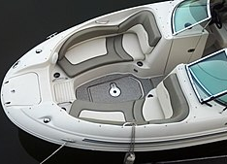
Shape of a Boat Rider Boat
“Bowrider” describes the watercraft’s basic designing, which is typically highlighted by a deep V-shaped hull.
These watercraft are defined by open front seats rather than a cabin.
A bowrider is utilized for travelling as well.
The name originates from the fact that a lot of bowriders incorporate a U-shaped lounge in front of the cockpit.

Slide 4
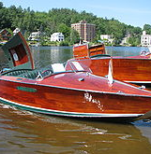
Other Names for Bowrider Boats
A Bowrider boat otherwise called a cabin cruiser boat is a runabout that features an open seating arrangement as well as speedier handling than a traditional motorboat
Bowrider boats are built for traveling and have in the most part some kind of ski pylon.
Planned for boating and boating delight on lakes or rivers, ocean and swamps.
Reasons for getting a boat is fun, entertainment, relaxation and recreation involving family members, friends while you are on the move.
A bowrider boat is a small watercraft.

Slide 5
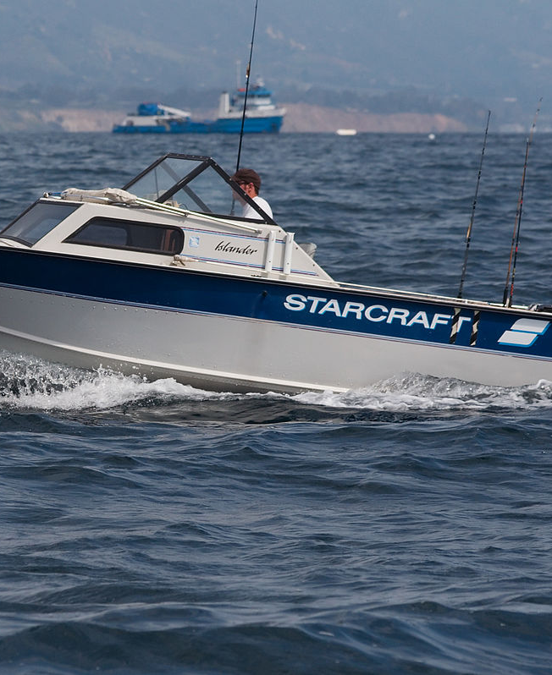
Can you use Bowrider Boats for Fishing?
Well suited for many recreational water sports such as tubing, water skiing, and swimming
Bowrider watercraft is stylish, smooth and made for a great time.

Slide 6
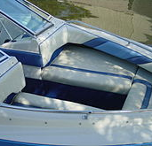
What are Bowrider Boats?
The bowrider was initially developed as a leisure watercraft and every design has open-bow seats with many areas to sit and relax.
A bowrider is geared up with a low-emission engine that provides lots of efficiency leaving no influence on the atmosphere or your pocketbook.

Slide 7
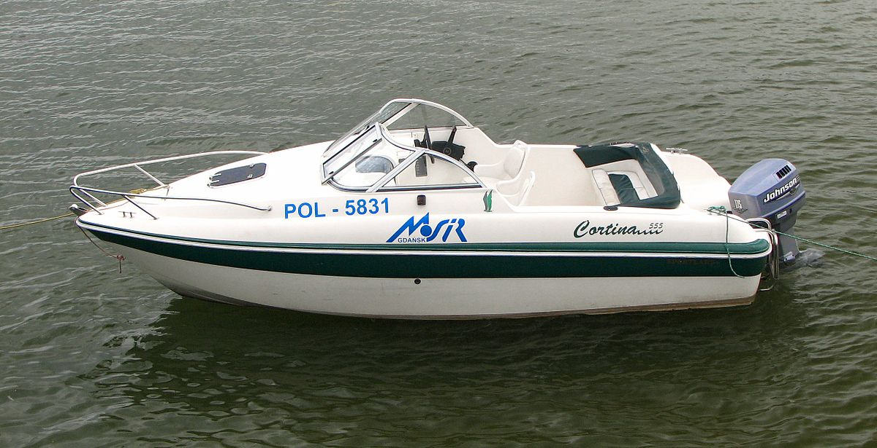
Types of Bow Riders
“Bowrider” describes the watercraft’s basic designing, which is highlighted by a deep V-shaped hull.
Early designs of this watercraft were usually smaller in dimension, with a size of 16-20 feet.
There are also different electric motor alternatives for these watercrafts, consisting of outboard, inboard, and jet drive.

Slide 8
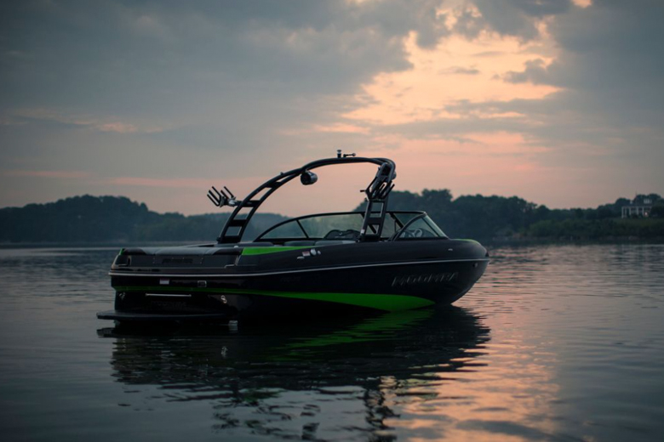
Legal Considerations vs. Lengths of Bowriders
Bigger versions consisting of designs approximately 35 feet long and almost 10 feet wide.
These bigger watercraft might also have much lesser sharp hulls and supply added functions, like exchangeable or electrical seats, wakeboard towers,
it’s only lawful to trailer in many states and carry a watercraft as much as 8 feet 6 inches, so you may require to get a unique license if you select a bigger bowrider design.

Slide 9
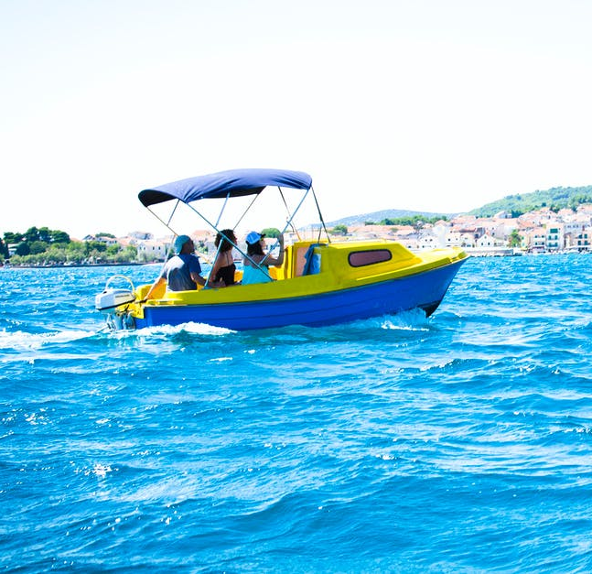
Do Bowriders have Cabins?
Mid-Cabin Bowriders are a more recent design on the market, supplying a sort-of hybrid boat.
Cabins can be furnished with environment control, TV, and much more.

Slide 10
Can you use Bowriders for Angling?
Bowriders are not used for fishing but there are models that are made for winter sports and angling.
Those use exchangeable and detachable seats that end up being angling chairs.
The most preferred bowrider on the market now is the jet boat.
The jet engine leaves even more space for additional seats and supplies more secure maneuvers without any requirement for a prop.
They are also fast.

Slide 11
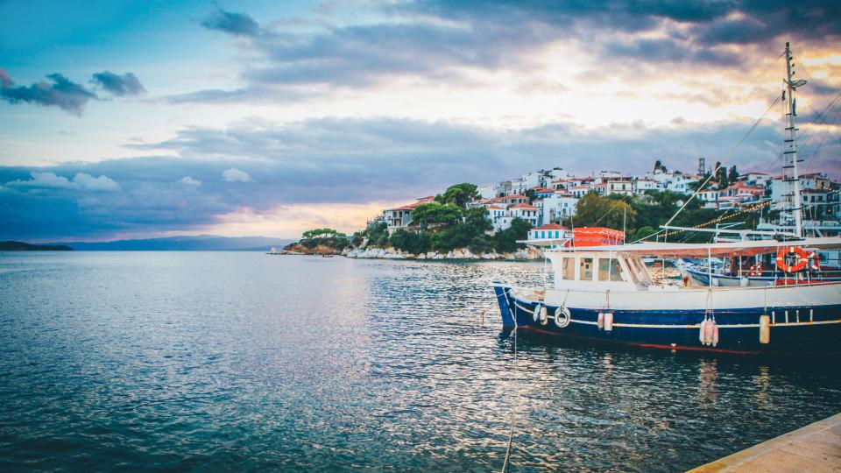
Pros and Cons of Bowrider Boats

Slide 12
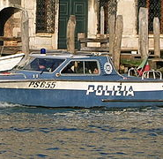
Benefits of Bowriders
  A Bowrider Boat is the ideal watercraft for all types of boaters, whether you’re a watersports fanatic or just need to have your children around.
  Bowrider boats are one of the most versatile types of boats to choose from for all sorts of pleasure boating
  Often it is referred to as a Sportsboat
  Versatility and Customization
  Affordability – Because they range in styles, they also range in prices
  Seating– A bowrider is perfect for entertainment and family boating because of its capacity
  Easy to Drive – Because of their narrow bow and wider back, they can navigate not only sharper turns
  Speed – up to 60 mph and bowriders’ sizes can range from about 20’ to 35’.

Slide 13

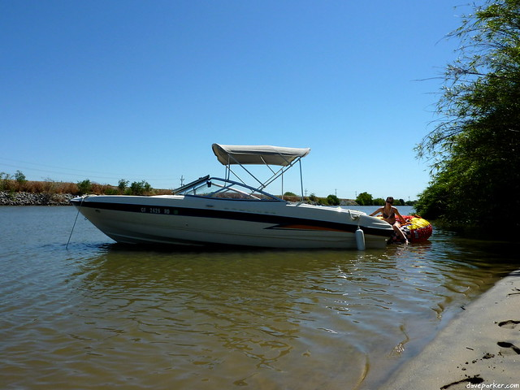
Drawbacks of Bowrider Boats
They are generally more expensive than runabouts.
bowrider boats do not have much speed
Limited Overnight Use
Narrow Seating in Front.
Special Permit Required to Tow Large Bowriders.
Limited Space for Large Groups

Slide 14
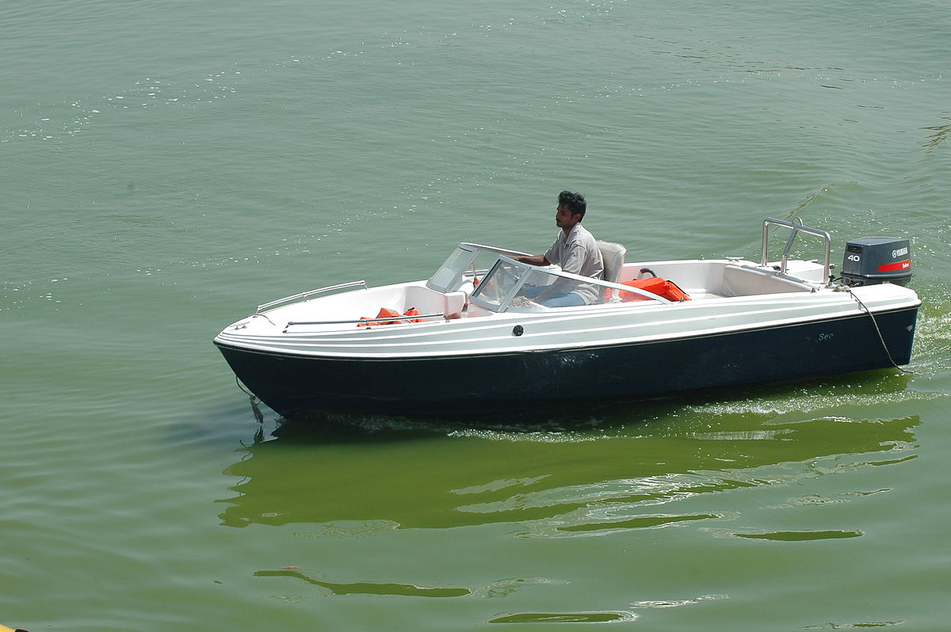



FOLLOW US
&
SUBSCRIBE
Facebook
Twitter
YouTube
@boatalert
@hindecoder
Boat Alert

Slide 15
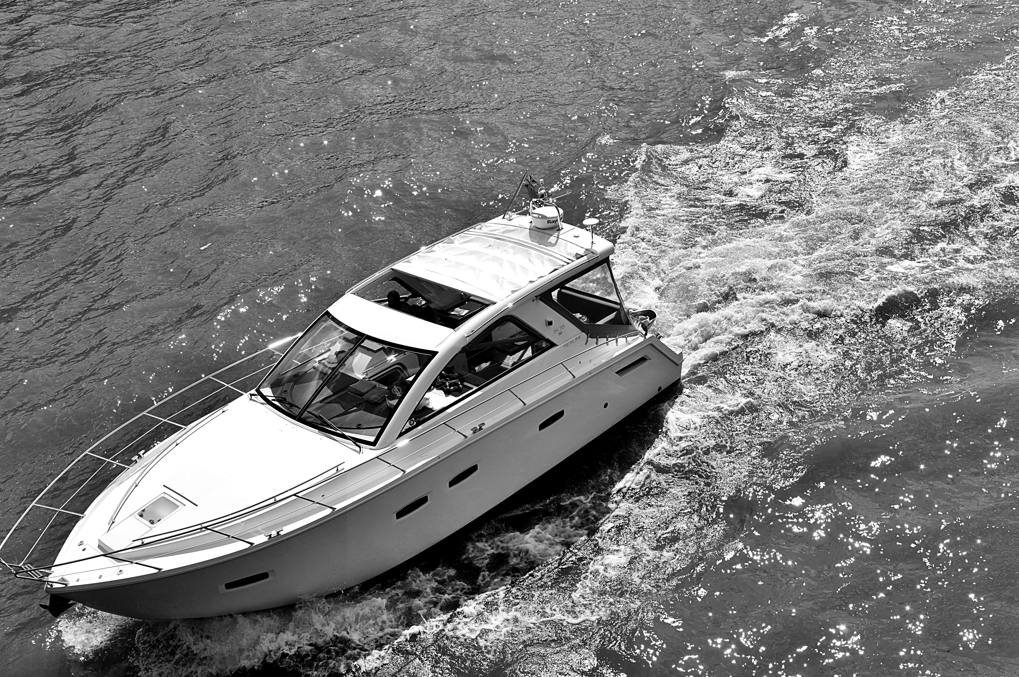
Article
https://www.boat-alert.com/blog/what-are-bowrider-boats-overview-of-bowrider-boats/
THANK YOU FOR LISTENING
Website
www.boat-alert.com
Email
boatalert@ certifiedreports.zohodesk.com
Contact number
1-855-HIN-ALERT

