Slide 1




surprises you will find in Today’s Center-Consoles

Slide 2

ANGLERS, WHAT’S IN THAT CENTRE-CONSOLE BOAT?
10 surprises in these boat models we love!
Helm Station mounted near the center.
Open; have a variety of propulsion
Outboard engine

Slide 3


Why Buy a Center-Console?
Great for Fishing
Shade producing T-top
Cheaper
Lighter; Perform better with same horsepower

Slide 4

CENTER-CONSOLE BOAT MODELS
Variety of newer models
Bigger and more spaced
Air-conditioning
Twin, triple & quadruple outboards
Flexibility to innovate
Remember to check the Boat-Alert.com history report for your HIN before you buy!

Slide 5

COOL CENTER-CONSOLE FEATURES
Chris-Craft Catalina 34 has lots of light and impressive amenities
Chris-Craft Catalina 34 has a horizontal window of the sunpad
Cobia 296 CC has a big stand-up head compartment for a 30ft boat

Slide 6

COOL CENTER-CONSOLE FEATURES
Porta-potties and even toilets plumbed to holding tanks
Cobia 296 has a small vanity with a sink, pressure water, and storage drawers underneath.

Slide 7
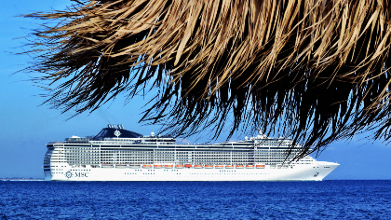
COOL CENTER-CONSOLE FEATURES
Vanquish 24 comes with inboard power, outboard-free transom. This gives fuel efficiency and a low center of gravity.
4200 Siesta offshore CC boat that can be powered by different outboard configurations.

Slide 8

OTHER AWESOME CC BOAT FEATURES
Some have large livewell tanks
Everglades 435 CC is 45 ft, has quad Yamaha 300-350 hp engines
570 gallons tank built to run those engines
Queen-sized bed converting to couch

Slide 9
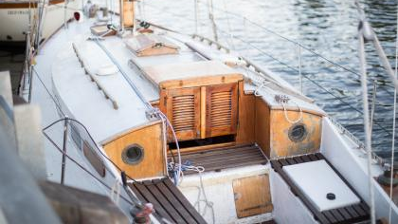
OTHER AWESOME CC BOAT FEATURES
Added Navigation gear; dashboard to fit electronics
Airconditioning, 19 flat-screen with DVD, porcelain toilet, refrigerator, hot/cold water, microwave
Catalina 34 has a narrow window for light

Slide 10
OTHER AWESOME CC BOAT FEATURES
Aquasport 2500 CC has Kevlar-reinforced hull
240 Dauntless CC boat with ergonomically designed seating
Robalo R230 features vertical storage for fishing rods

Slide 11




Facebook
@boatalert
Twitter
@hindecoder
YouTube
Boat Alert
FOLLOW US AND SUBSCRIBE

Slide 12
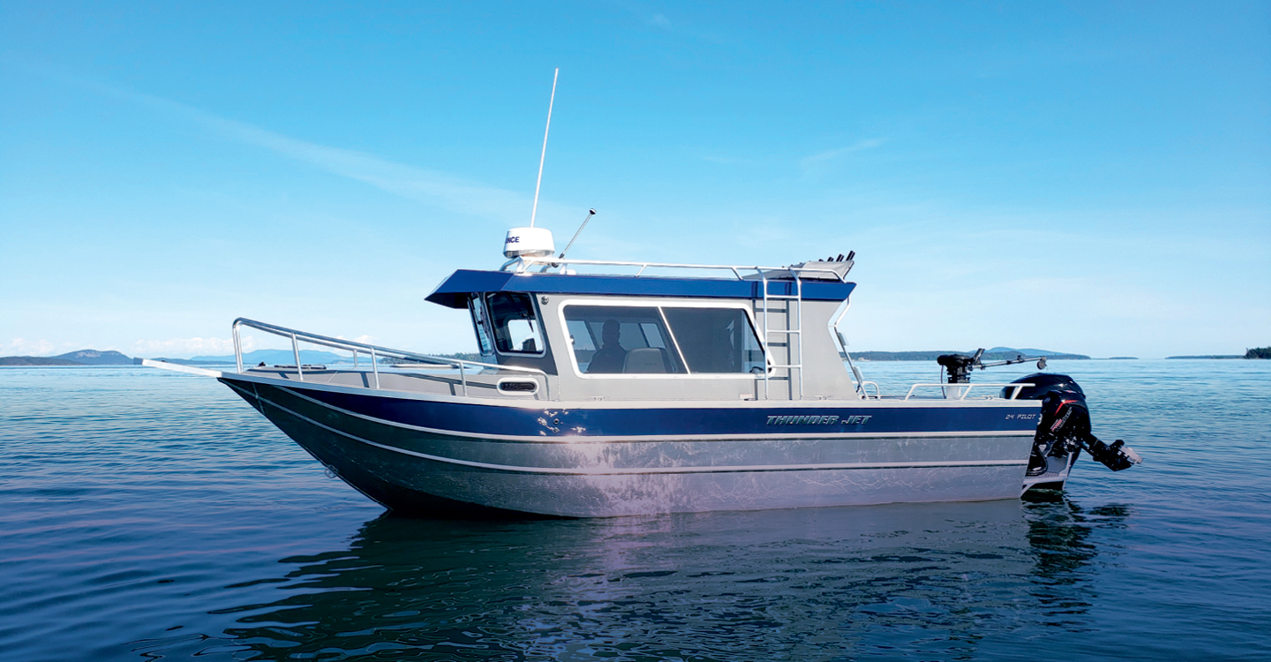
Thank you for Listening!
Full Article:
https://www.boat-alert.com/blog/what-are-10-surprises-you-will-find-in-these-center-consoles/
Website:
www.Boat-alert.Com
Email:
Boatalert @certifiedreports.Zohodesk.Com
Contact Number:
1-855-HIN-ALERT

