Slide 1


Best Step by step guide to selling your Boat
(How to Sell a Used Boat)

Slide 2

Boat Selling Process: Step-By-Step Approach
Prepare your boat for Sale
1
Take On-the-Water Photos and Videos
2
Set your Price
3
Get a Boat Survey Done or Obtain a Boat Alert History Lookup
4
Advertise your Boat to the Classified sites
5
Show your Boat in-person or via Virtual Boat Tours
6
Sell your Boat with a Bill of Sale, Title and Documents
7
Get Help from a Ship Dealer or a Yacht Broker
8
Sell the Used Boat on a Trailer
9

Slide 3

PREPARE YOUR BOAT FOR SALE
Fix Mechanical Issues.
Take care of “Quirks”.
De-clutter!
Clean the Yacht Cabin

Slide 4

BOAT PHOTOS
Once the boat is in good shape, take some on-the-water photos.
Backdrop is important.
Primary impression is vital.
Avoid photos of boat on trailer.
Avoid bad lighting and cluttered background.
Listings with videos sell better.
Listings with Boat-Alert History check also sell fast.

Slide 5

SET YOUR PRICE BASED ON YOUR BOAT’S VALUE
Get the Market Value.
Read up on best ways to price your boat.
Starting point can be the boat value calculator on HinDecoder.com .
Decide if the survey needs to be done.
A survey before time can unveil common issues that can be addressed and fixed in time.

Slide 6

ADVERTISE YOUR BOAT: WHERE TO LIST IT?
Places you usually shop for a used boat.
Consider websites like:
  Craigslist
  Boats.com
  Boat-trader

Slide 7

SHOW YOUR BOAT: VIRTUALLY OR IN-PERSON
Show your boat to potential buyers by virtual tours via video calls or in-person sea trials.
Be prepared to answer questions on model, condition and key features.
Mention the add-ons you’ve installed over time.
BEWARE OF SCAMS!

Slide 8
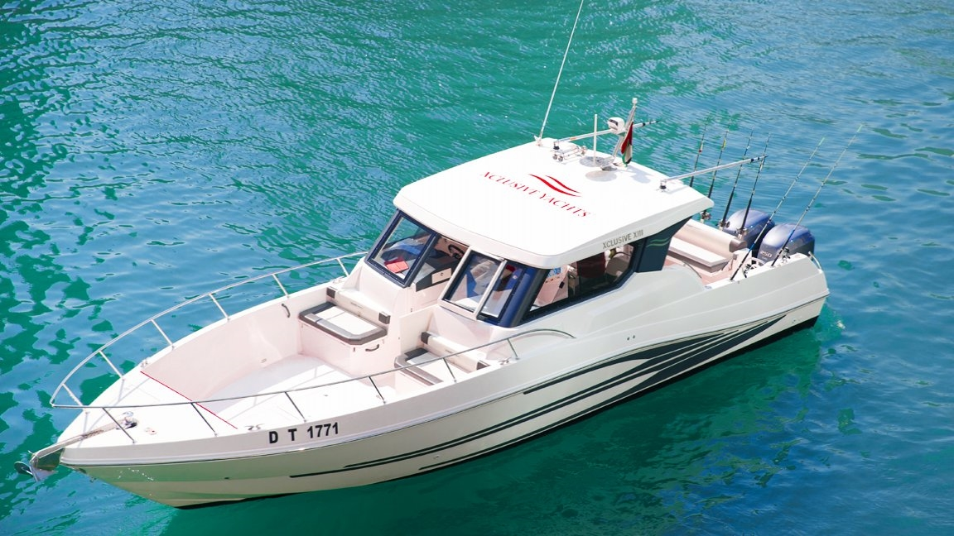
Proper Documentation
Check that Paperwork is in order.
See that maintenance records and invoices can be provided as a record.
Get the Boat-Abstract.com report if this is a USCG documented vessel
You can always reach a knowledgeable boat broker for assistance in selling the boat.

Slide 9






FOLLOW US & SUBSCRIBE
Facebook
@boatalert
Twitter
@hindecoder
YouTube
Boat Alert

Slide 10

Read Full Article: https://www.boat-alert.com/blog/best-step-by-step-guide-to-selling-your-boat-how-to-sell-a-used-boat/
Website: www.boat-alert.com
Email: boatalert@ certifiedreports.zohodesk.com
Contact Number:
1-855-HIN-ALERT
Thank you for Listening!

