Slide 1


Selecting the Right Personal Water-Craft (PWC)

Slide 2


Buying a Personal Watercraft
Choose the fastest (most horsepower) model but make sure it is light (highest horsepower-to-weight ratio)
Prices are all about the same or at least very affordable.

Slide 3

Boat History Check
Check the boat history from Boat-alert.com if you’re buying a used watercraft. Then get a marine surveyor.

Slide 4
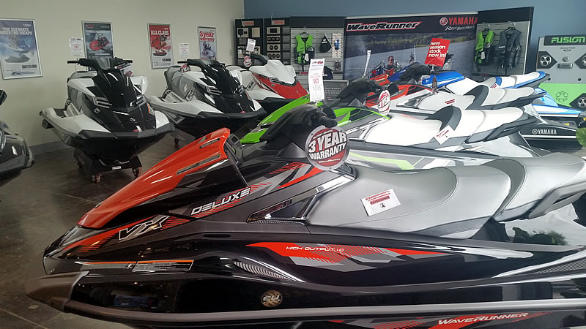
PWC Boat Manufacturers
Fewer manufacturers than before
Honda and Polaris joined but soon left the PWC manufacturing industry
Trusted manufacturers are:
  Sea-Doo
  Kawasaki JetSki
  Yamaha WaveRunner

Slide 5
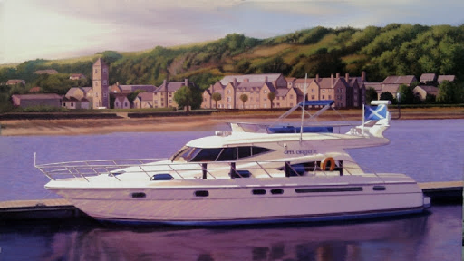
SIT-DOWN
OR
STAND-UP

Slide 6
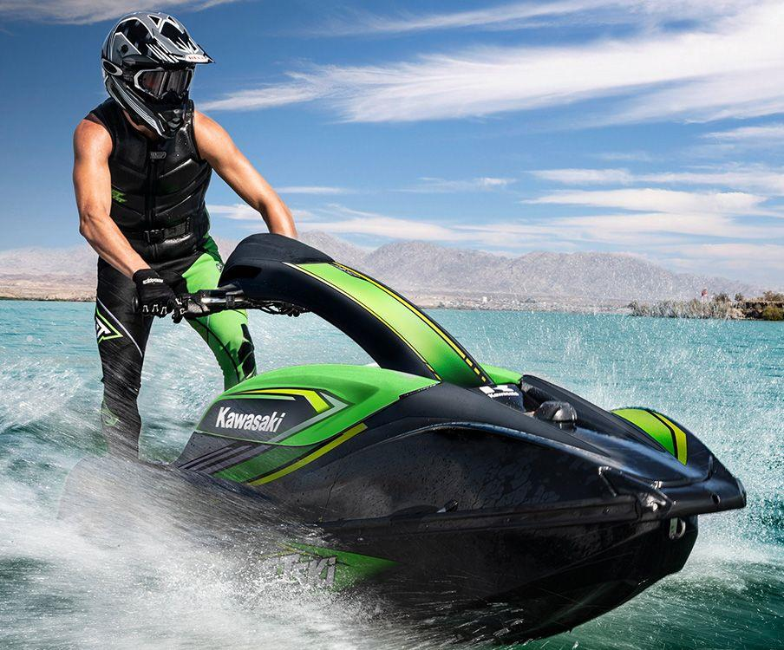
STAND-UP
PWC Type
For standing type
There are only two manufacturers:
  Kawasaki
  Yamaha
If you’re trying to find something physical, stand-ups are your game, and both models are about $10 grand USD
Sit-down Watercraft holds the biggest market share and shorter learning curve.

Slide 7
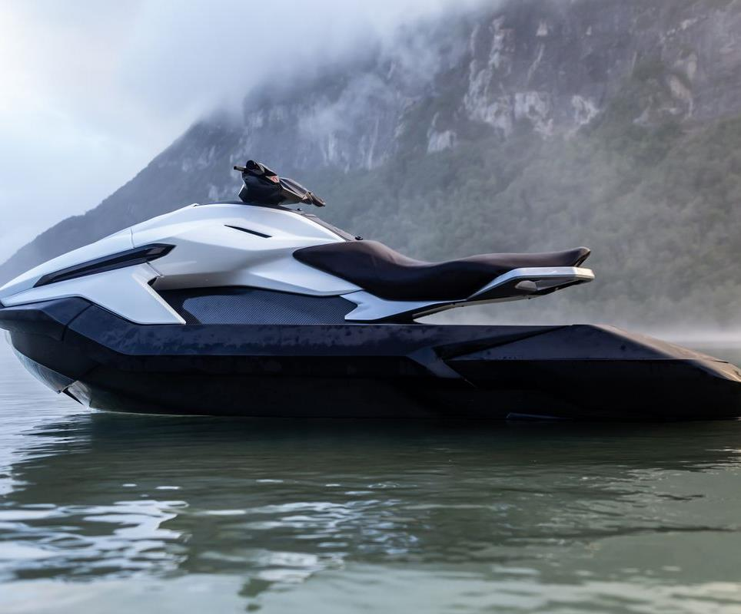
SIT DOWN
PWC Type
Manufacturers have:
  Delineated their models, with segments like performance and racing, luxury, recreation and recreation light
  “Tow Sports” from Sea-Doo is an exclusive category of PWC
If you have someone to boat with, consider buying one among the larger craft (Yamaha’s FX series) or buying two smaller craft (Sea-Doo’s GTS line)

Slide 8

Select a PWC for Inland or Open Ocean
For inland, having a closed cooling system doesn’t matter.
For Intracoastal Waterway and the ocean, closed cooling can prevent potential maintenance problems.
Note: More features make the watercraft heavier which makes the handling harder. It also makes pushing back into water harder after you park on-shore.

Slide 9
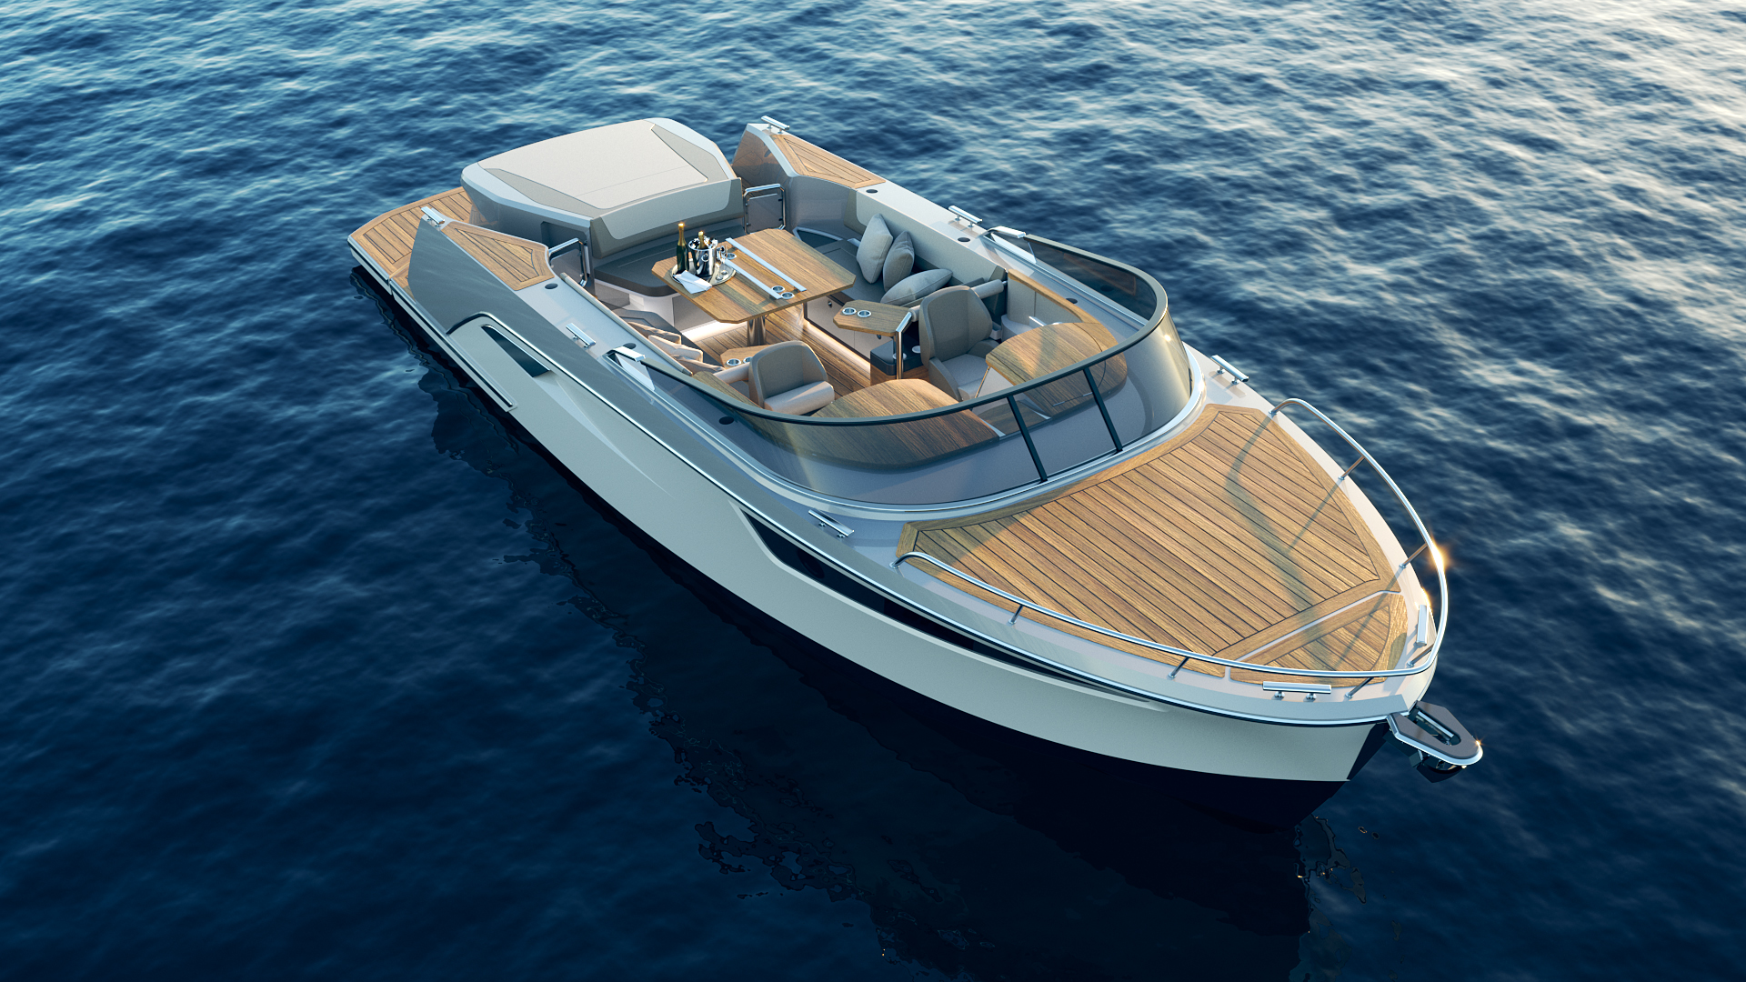
Once you’ve picked your style of PWC and narrowed it down to the top watercraft manufacturer and model, it will be time to spoil yourself with some additional add-on features.

Slide 10
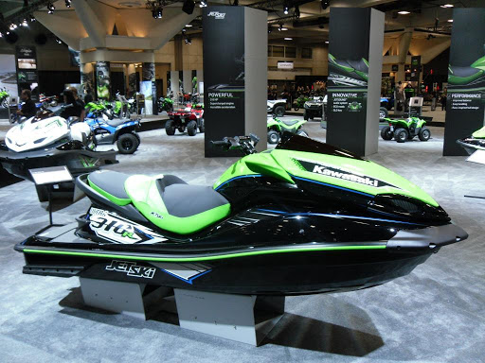
Extra Features
If you’re looking for acceleration and top speed, manufacturers offer supercharged engines.
If you want safety systems, look out for
  Sea-Doo’s Intelligent Brake and Reverse system
  Kawasaki’s Smart Learning Operation feature
  Yamaha’s Ride system lets the driving force switch from forward to neutral to reverse with one pull of the throttle

Slide 11
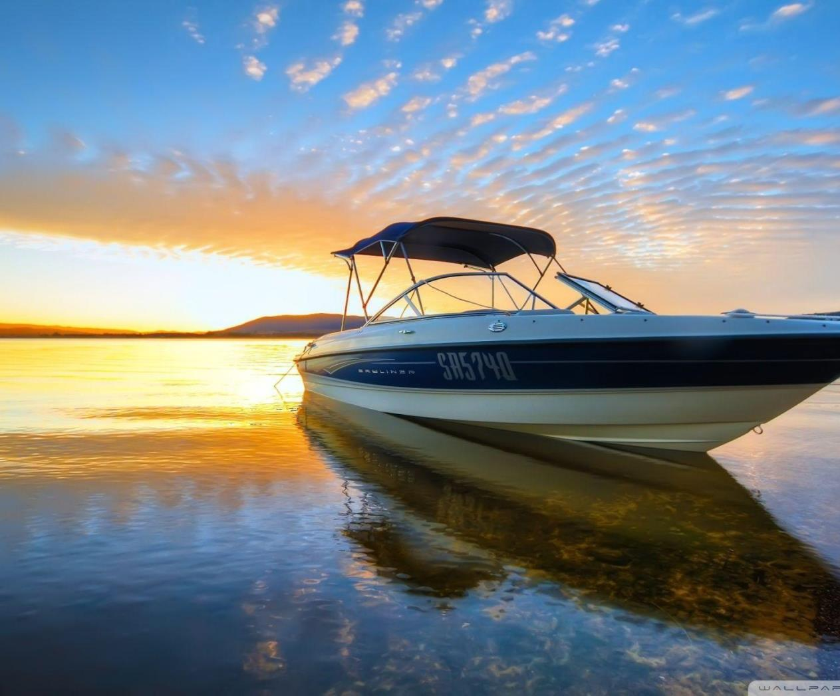
Extra Features
If you’re bringing a lot of people, some models include
  12-volt power outlets, so you’ll charge your phone while riding
  Stereo systems
  Cruise control

Slide 12
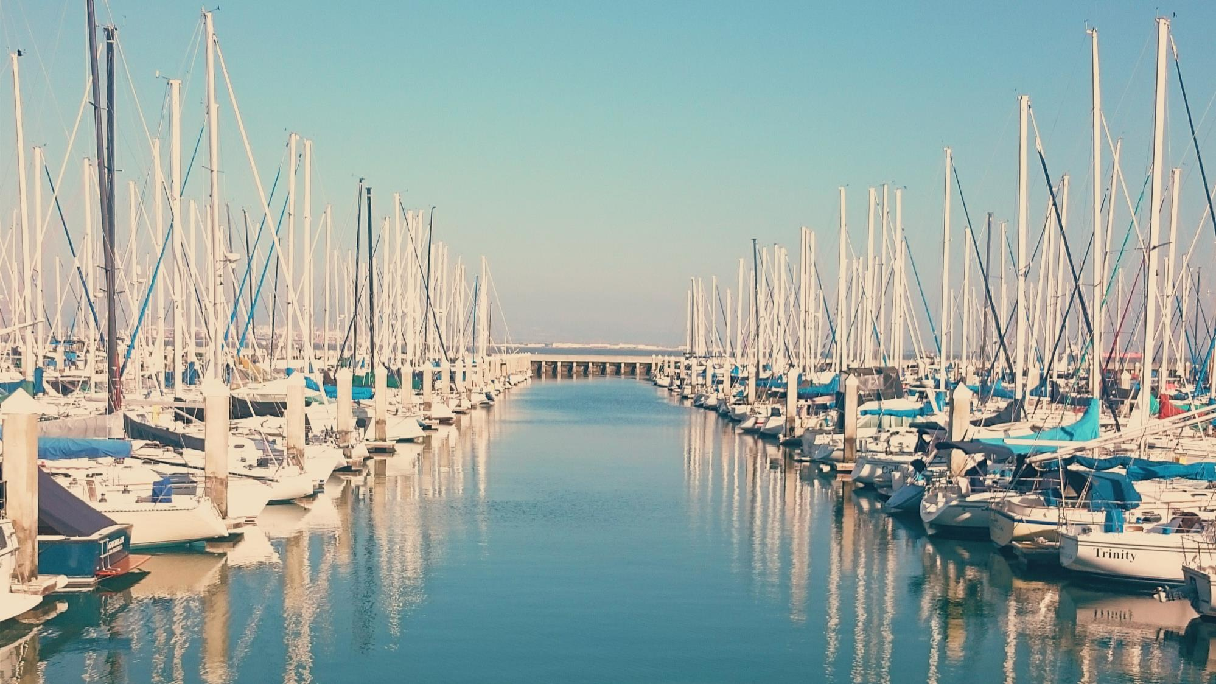
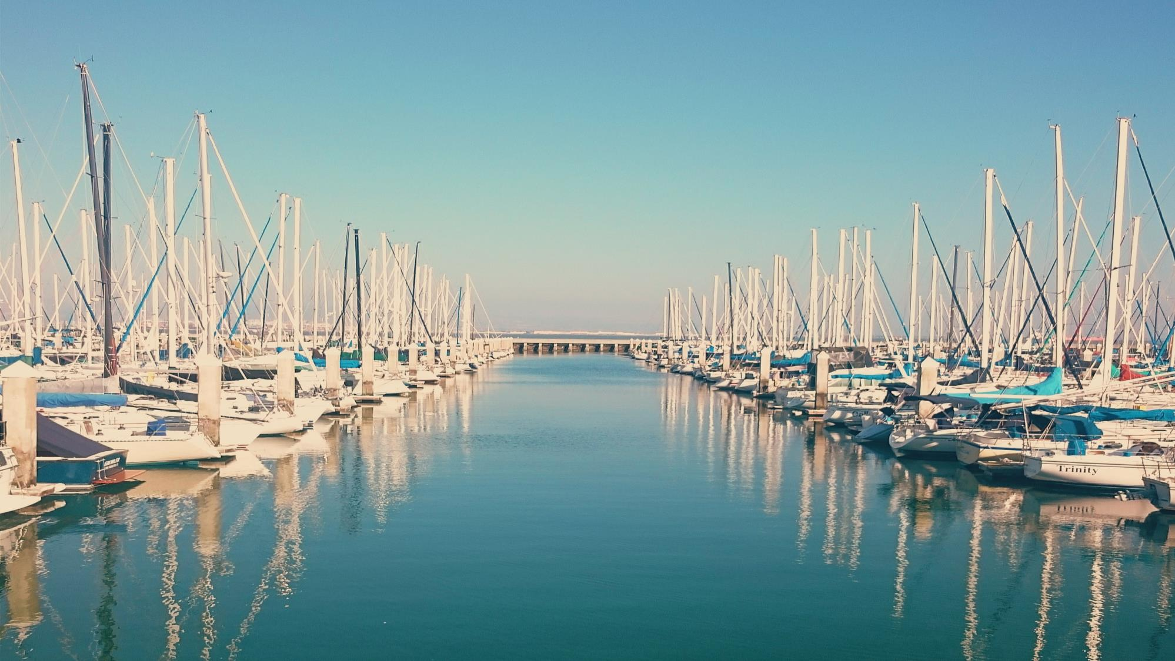



FOLLOW US & SUBSCRIBE
Facebook
@boatalert
Twitter
@hindecoder
YouTube
Boat Alert

Slide 13

Full Article: https://www.boat-alert.com/blog/this-is-how-you-select-the-right-personal-water-craft-pwc/
Website: www.boat-alert.com
Email: boatalert@ certifiedreports.zohodesk.com
Contact Number:
1-855-HIN-ALERT
Thank you for Listening!

