Slide 1


Ideal Ways to Keep Your Boat Safe and Secure in Winter Storage

Slide 2

Boat Storage in Winter

Slide 3
BOAT ALERT HISTORY REPORT
Winter Season
Unattended Boats in Storages
Targets for thieves

Slide 4
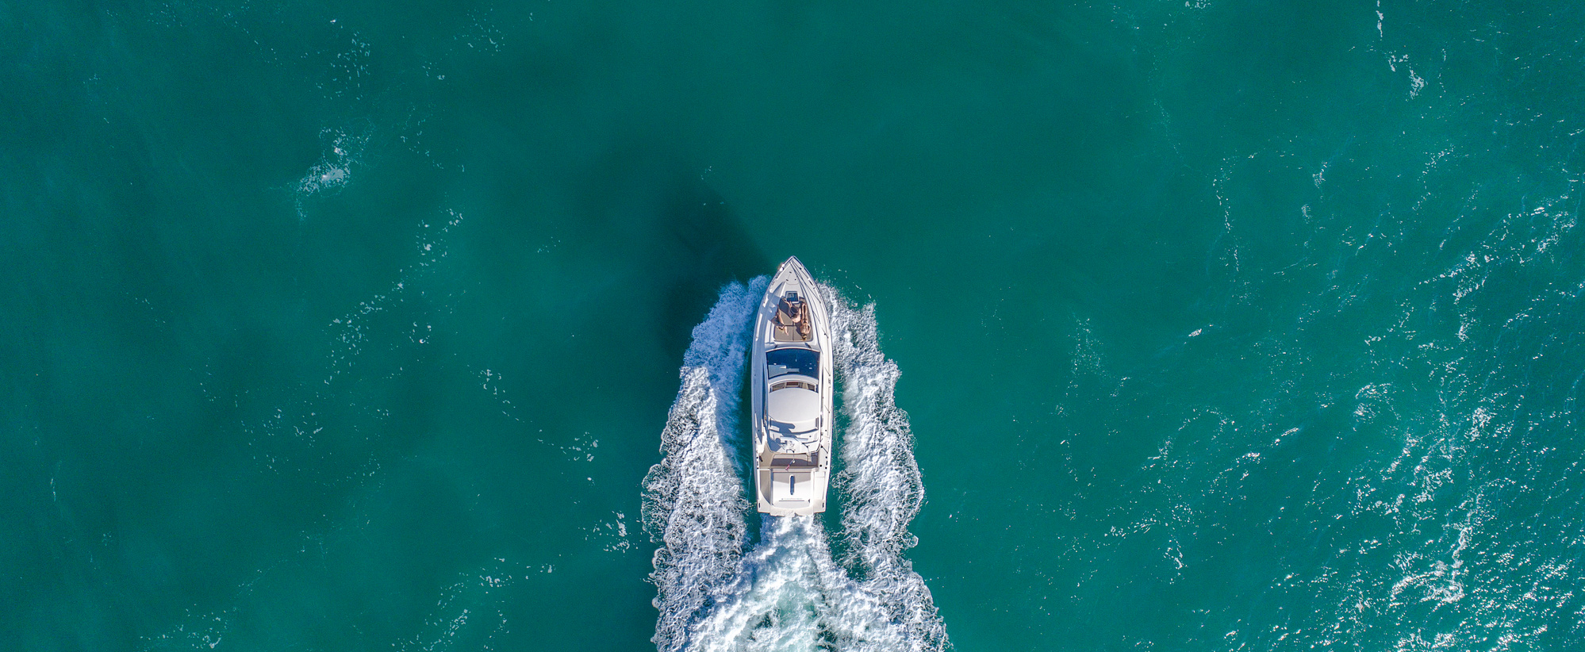

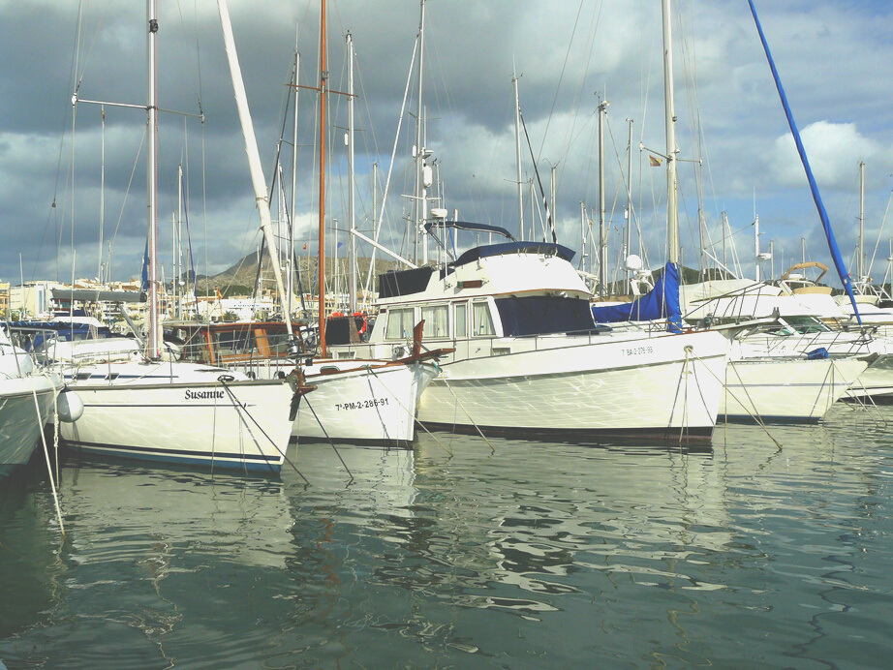
BOAT ALERT HISTORY REPORT
5 Things that can lure a Thief
  Electronics
  Watersports & Fishing gear
  Life Jackets
  Title of the Boat
  PWC or an outboard-powered boat

Slide 5


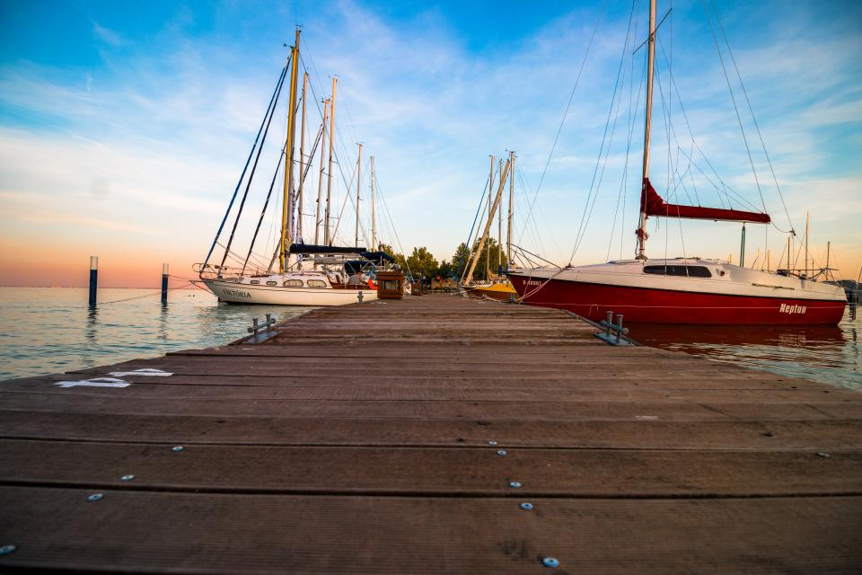
BOAT ALERT HISTORY REPORT
Safe boat storage
  Remove a wheel from an axle
  Install Hitch locks
  Store PWCs in secure facilities
  Remove outdrive and smaller outboards
  Install locks on larger outboards

Slide 6
Install locked gates
Post Marina Regulation Warning Signs
Limit access to authorized persons
At the marina
Install security cameras and good lights
Install a boat-theft system
Get acquainted with neighbors

Slide 7
Chain the trailer to a heavy post
Install a coupler lock
Remove the wheels and lock spare tire
On a Trailer
Remove smaller outboards
Lock larger outboards with purpose-made locks
Remove the License plate and taillights

Slide 8
Tie the boat to a secure post with a chain
Use one-way bolts & backup plates on eyebolts
Leave the boat’s engine out of commission
Dock Storage
Remove a few sparkplug wires
Install a hidden ignition or fuel cut-off switch
Secure outboard motors with special locks

Slide 9
Boat Buyers Beware
Be cautious of super “deals”
Always search the boat-alert.com database
Look out for the red flags to avoid scams
Make sure the boat has a valid HIN
Make sure the seller has original ownership documents

Slide 10




FOLLOW US
&
SUBSCRIBE
Facebook
Twitter
YouTube
@boatalert
@hindecoder
Boat Alert

Slide 11

Full Article URL:
https://www.boat-alert.com/blog/ideal-ways-to-keep-your-boat-safe-and-secure-in-winter-storage/
Website
Thank you for listening
www.boat-alert.com
Email
Boatalert @certifiedreports.zohodesk.com
Contact number
1-855-HIN-ALERT

