Slide 1
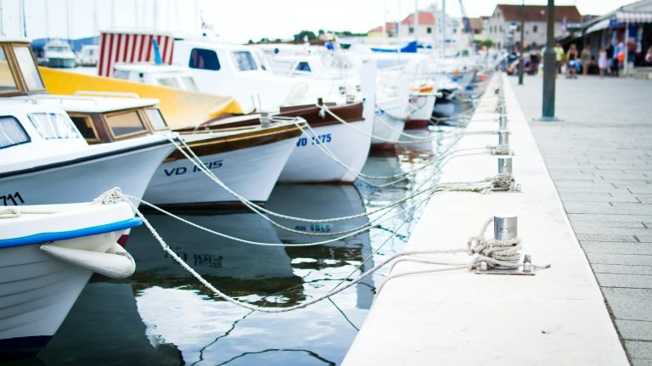

Used-Boat Buying Season
When to buy a used boat

Slide 2
BOAT ALERT HISTORY REPORT
When is boat-buying season?
Storing boats for winter
Buying new watercraft for spring
Placing old boats up for sale after summer
When dealers and manufacturers start their incentives
Fall and early Winter
When dealers need to make space for new models
So, buying season coincides with used-boat selling period
02

Slide 3


BOAT ALERT HISTORY REPORT
When is that Season?
  Just before the Big Boat Shows that draw out interested individuals
  More boat sellers mean more used-boats to pick from
  BEST TIME TO SHOP for a used-boat
  Sellers want to avoid storage costs and need down payment
03

Slide 4
BOAT ALERT HISTORY REPORT
Look out for ads on BoatTrader.com, Facebook Marketplace, and Craigslist.
Reduce the price to a suitable offer once the supply appears high.
Don’t forget to check Boat-alert.com for the boat history (carfax for boats) before you buy.
What To Do?
04

Slide 5




FOLLOW US
&
SUBSCRIBE
Facebook
Twitter
YouTube
@boatalert
@hindecoder
Boat Alert

Slide 6

Full Article:
https://www.boat-alert.com/blog/used-boat-buying-season/
Thank you for listening
Website
www.boat-alert.com
Email
boatalert@certifiedreports. zohodesk.com
Contact number
1-855-HIN-ALERT

